Slide 1
exhibition fair of Cali
Yeison Trujillo
Juan José Figueroa
Sebastián Pereira
Grado 9-2

Slide 2
fair of Cali
Cali Fair, also called Fair reed, is a holiday celebrated annually since 1957 in the city of Cali in Colombia that takes place between 25 and 30 December.

Slide 3
HISTORY FAIR OF CALI
On August 7, 1956 occurred in the city a huge explosion, tragic event that generated ruins, loss of life and considerable economic recession in the city. The authorities decided to organize an exhibition next year as an opportunity to overcome the tragedy and an engine of economic recovery. The first fair of Cali

Slide 4
Salsódromo
The Salsódromo is the opening event Cali Fair has a space for the parade of the most cultural attraction: the Salsa

Slide 5
Election of the fair Disk
It's a song that represents each year the spirit of the festivities. The management organization of the fair (Corfecali) has promoted an annual contest for citizens to choose the disk to fair the year.

Slide 6
CALI OLD CARNIVAL
On December 28 the Southeast Expressway will be to witness the great Carnival Cali Viejo, a tradition of the Cali Fair rescuing the culture and idiosyncrasies of Cali.

Slide 7
CLASSIC CARS PARADE AND OLD
In this parade, the owners of the most luxurious and classic cars on display They are shown

Slide 8
DAY PACIFIC
This event rescues the values of ethnic population of African descent represents a large majority in the territory Vallecaucano

Slide 9
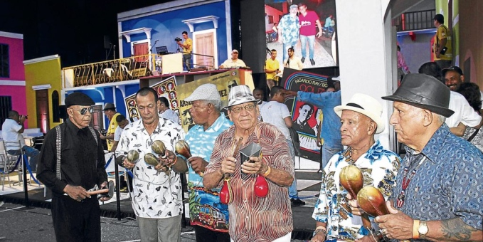
Meeting of Salsa music lovers and collectors
The sauce has a very special place for all music lovers and collectors who exhibit the best of their salsotecas.

Slide 10
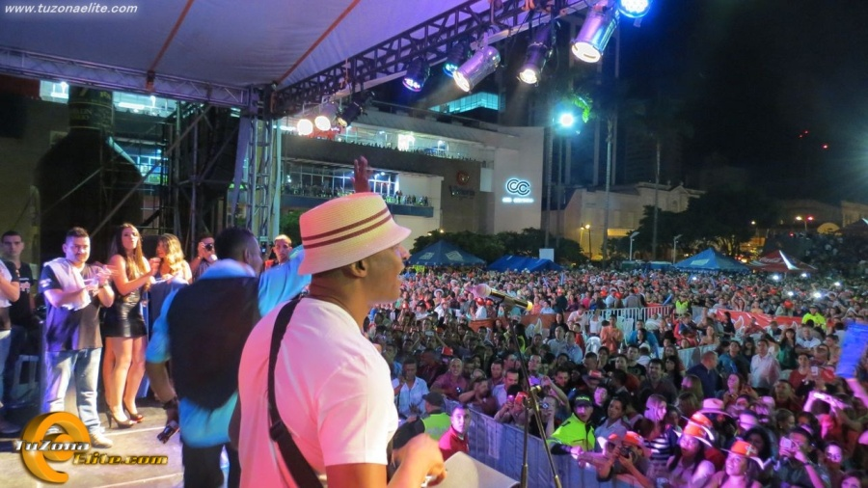
Super concert Cali Fair
Cali, known for having an excellent public proclamation to Super musical concert as the flagship event in the city and the fair. The event traditionally held on December 27, top best national and international artists in dance music are presented.

Slide 11
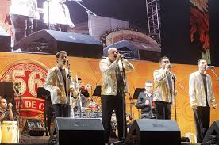
Festival of Orchestras
With the introduction of the 20 greatest projection orchestras nationally sharing the stage with big stars of salsa, it was held this December 30, version XVIIII the Festival of Orchestras of the Fair of Cali.

Slide 12
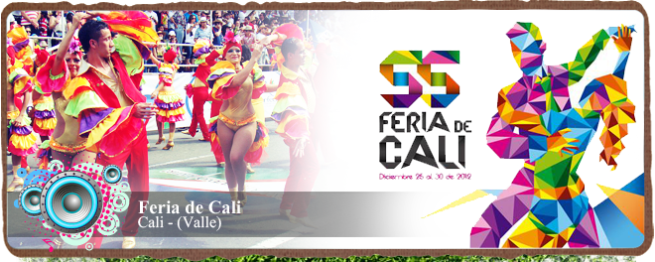
tourism
Cali Fair is an important event, attended annually 2.2 million people, calculating foreign tourists is a figure of 300 000. The fair come mainly for its climate, events and rumba; becoming one of the main tourist destinations in Colombia and Latin America between 25 and 30 December each year.

